Slide 1



01 - Project Proposal
2024.09.20
SKKUking
TEAM_D
2024 Capstone Design Project

Slide 2


01 - Project Proposal
2024.09.20
CONTENTS
About TEAM_D
Skills Required
Our Motivations
Our Approach
Topic
Planned Roadmap
2024 Capstone Design Project
01

Slide 3
01 - Project Proposal
2024.09.20
About TEAM_D
이승환
정재윤
이채연
박문희
Lee SeungHwan
Jeong JaeYoon
Lee Chaeyeon
Park MoonHee
Software Department
Team Leader
Development Manager
Architecture Department
Software Department
Backend Development
Biology Department
Software Department
Backend Development
Project Manager (PM)
Biology Department
Software Department
Frontend Developemnt
2024 Capstone Design Project
02

Slide 4



01 - Project Proposal
2024.09.20
Our Motivations
basically when living alone
Difficulties of managing foods
- expiration dates, keeping it fresh
- expect a simple, straightfoward manager to help
Ignorance of various easy recipes
- may possibly be your first time cooking yourself
- lots of challenging recipes to follow
2024 Capstone Design Project
03

Slide 5
01 - Project Proposal
2024.09.20
Topic
Simple Cooking Manager
for students living alone
Sharing Community
in SKKU
Web page
2024 Capstone Design Project
04

Slide 6
01 - Project Proposal
2024.09.20
SKKUking
2024 Capstone Design Project
05

Slide 7
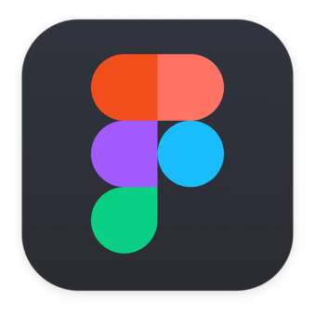


01 - Project Proposal
2024.09.20
Skills Required
2024 Capstone Design Project
06

Slide 8
01 - Project Proposal
2024.09.20
Our Approach
1
Develop a web that manages foods for students who live alone
2
Recipe recommendation system based on combinations of leftover foods
3
Easy -looking UI with self-customized service provided
4
Construct SKKU students' local community
2024 Capstone Design Project
07

Slide 9
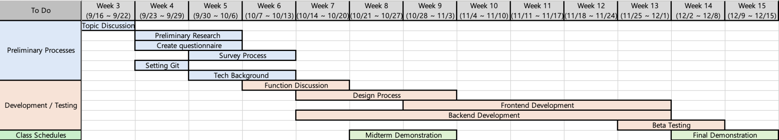
01 - Project Proposal
2024.09.20
Planned Roadmap
2024 Capstone Design Project
08

Slide 10
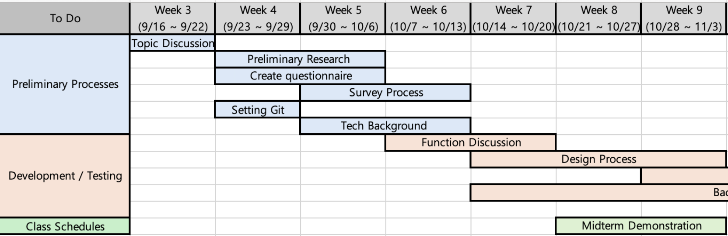
01 - Project Proposal
2024.09.20
Planned Roadmap
2024 Capstone Design Project
09

Slide 11
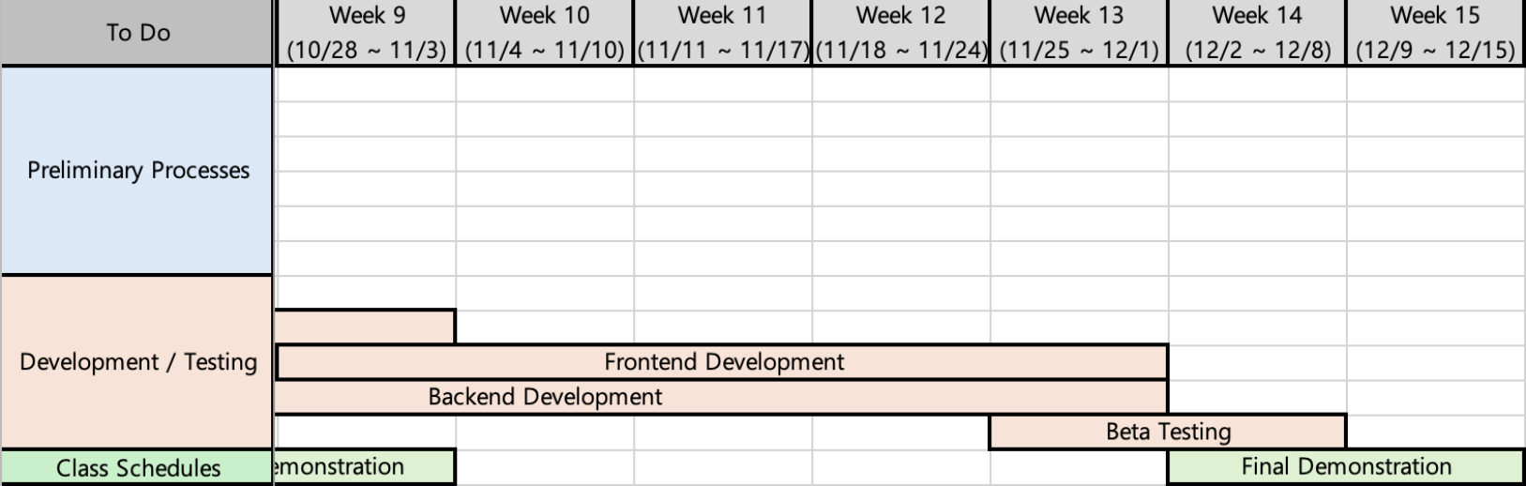
01 - Project Proposal
2024.09.20
Planned Roadmap
2024 Capstone Design Project
10

Slide 12


01 - Project Proposal
2024.09.20
Thank you
2024.09.20.
TEAM_D
2024 Capstone Design Project

